Slide 1
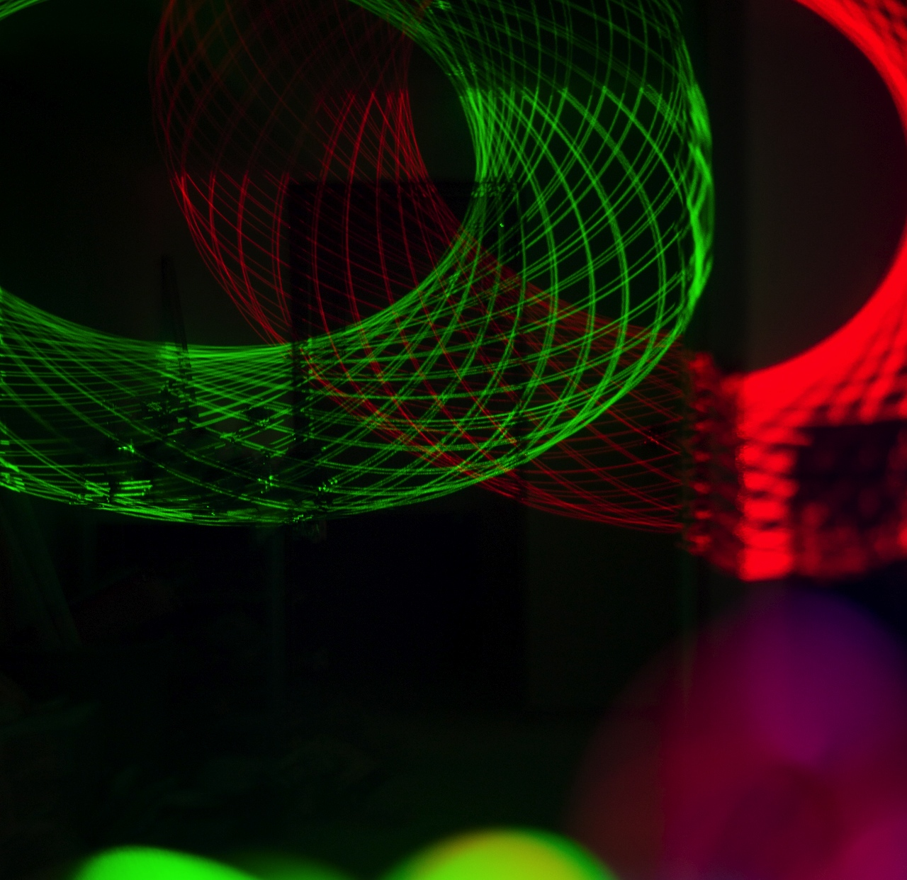
Arduino Laser Projector
Iulian Radu

Slide 2
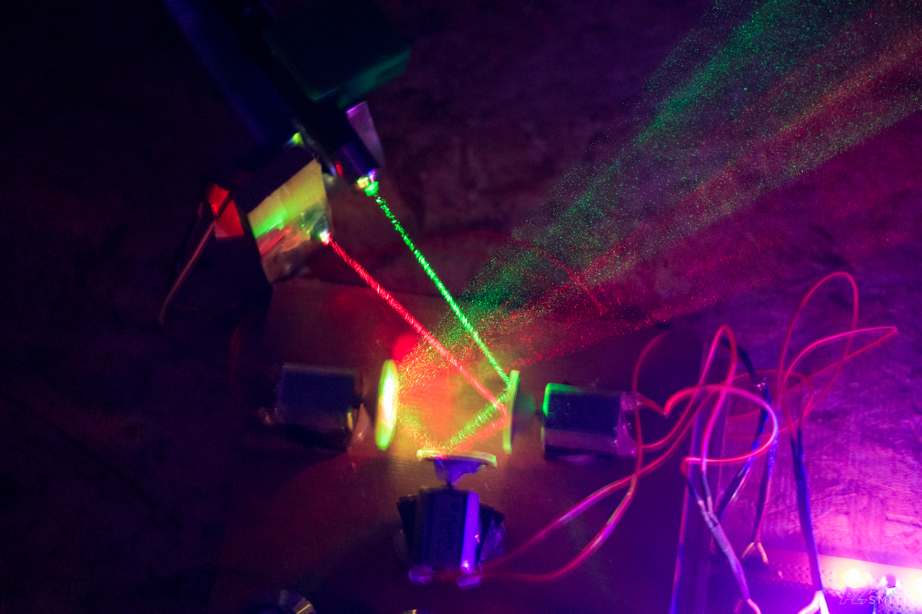

Slide 3
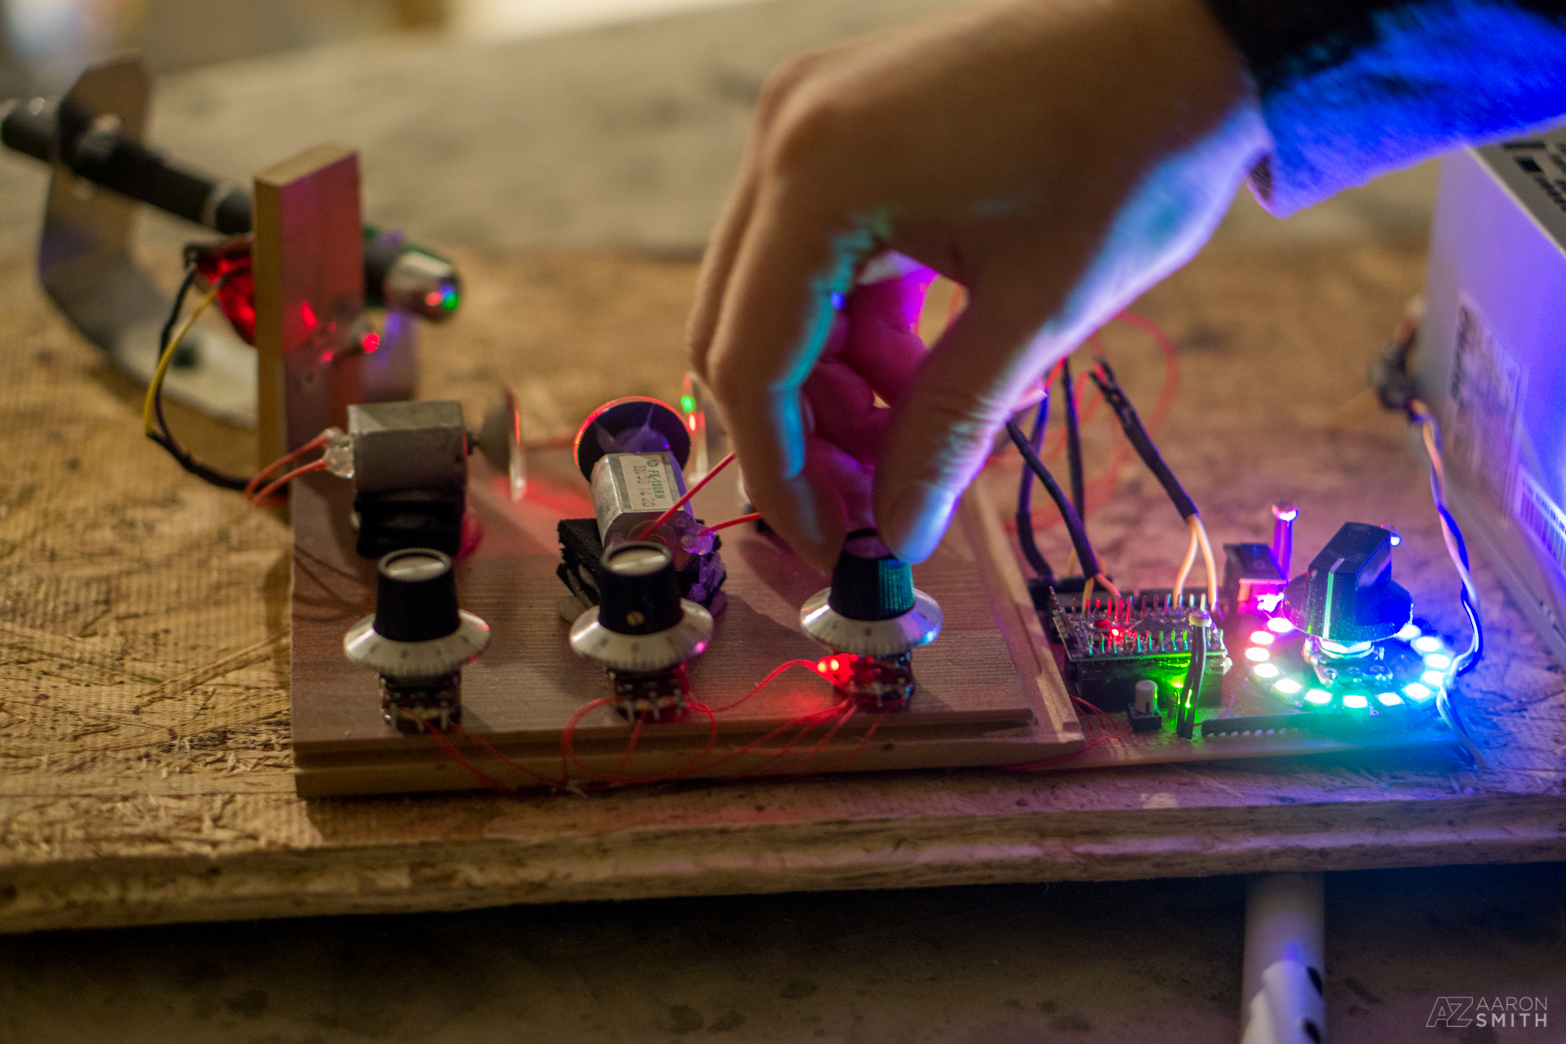

Slide 5
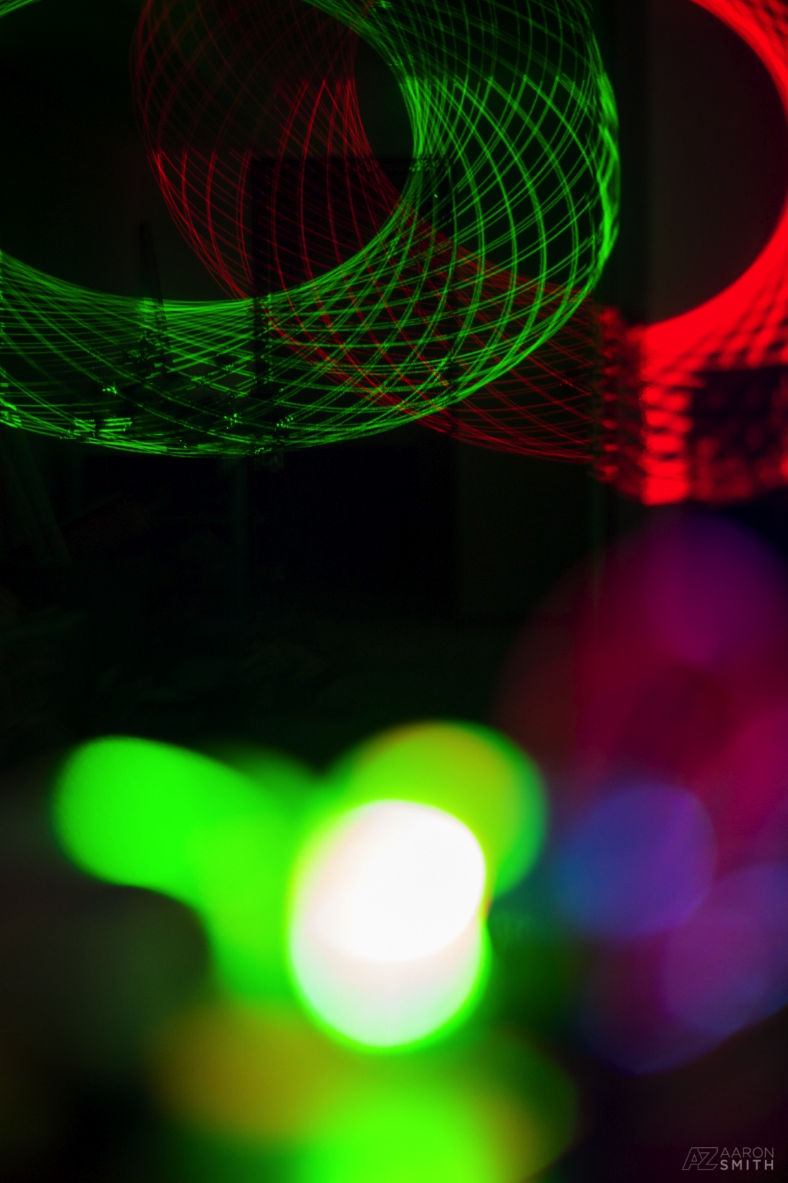
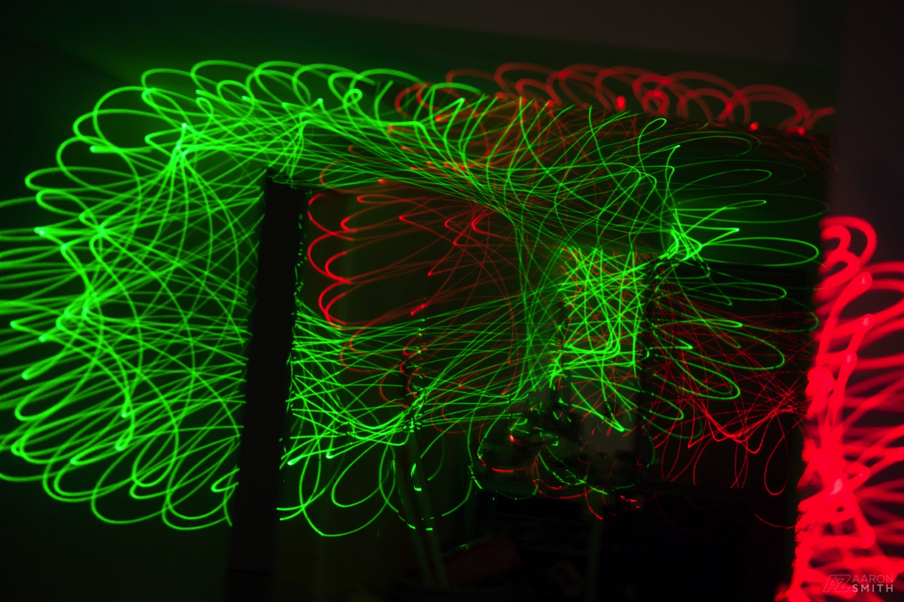

Slide 6
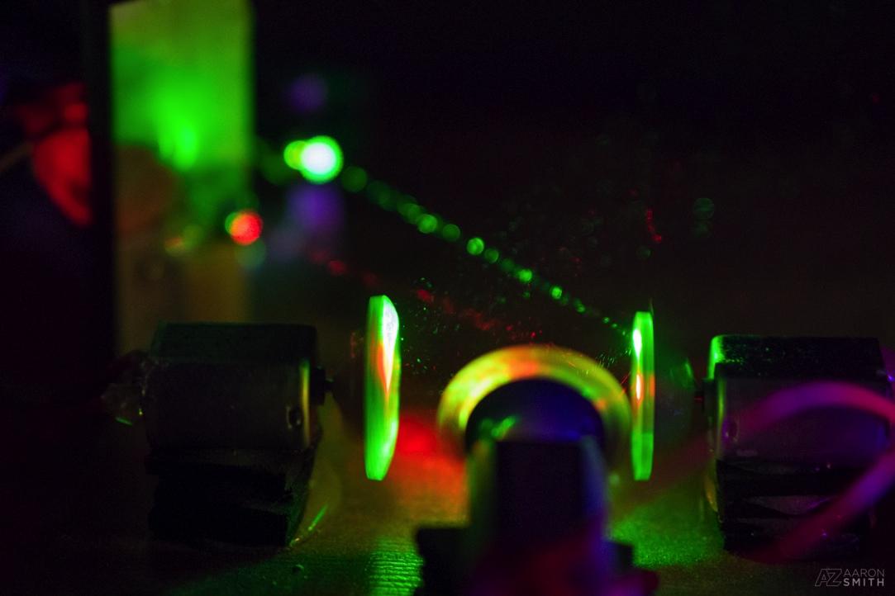
Features
Control 3 mirrors independently
Save the configuration (7 slots)
Replay & auto-play
Touchless control

Slide 9
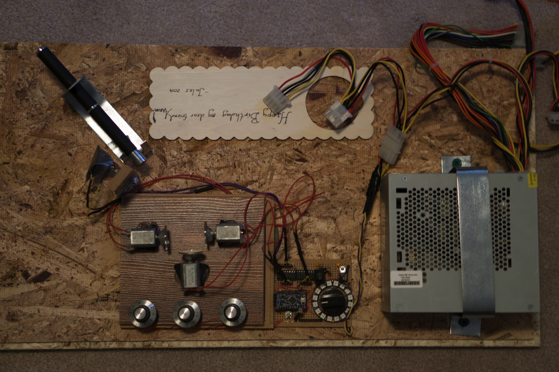

Slide 10
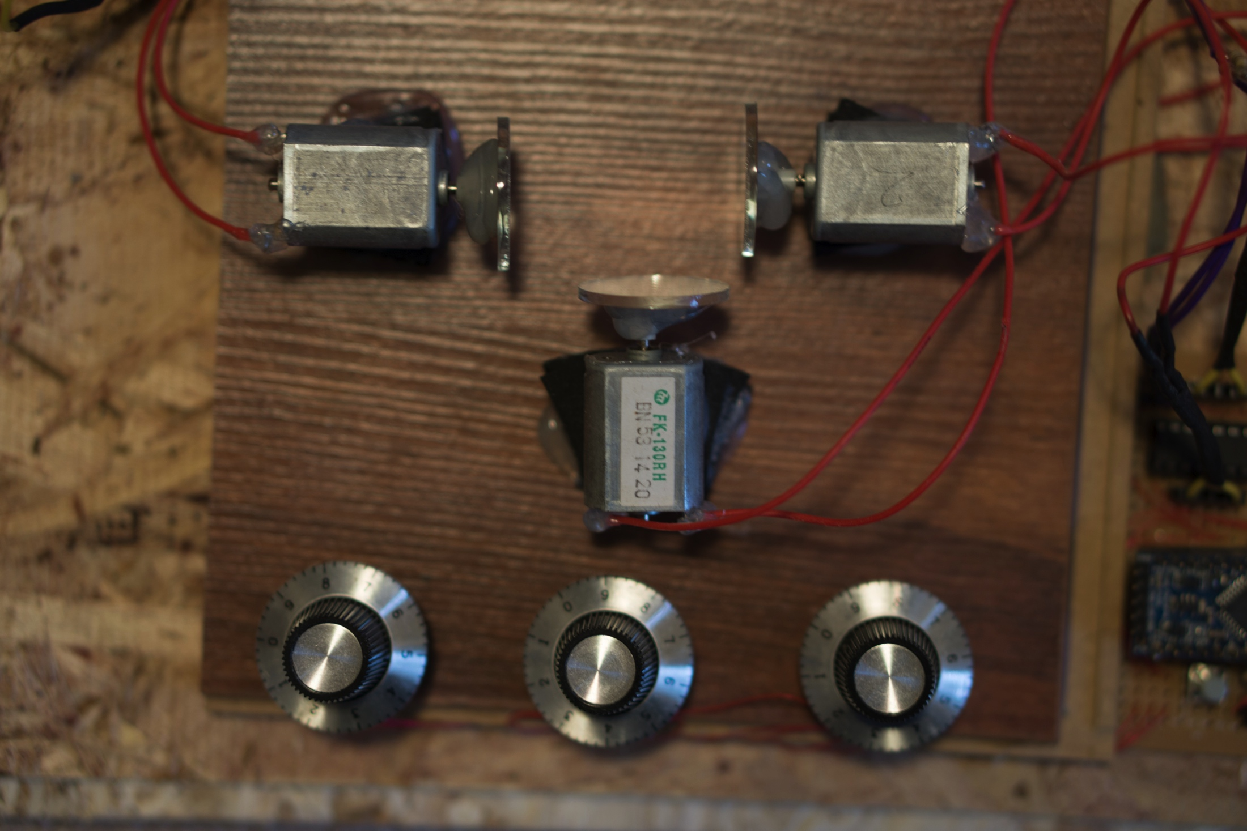

Slide 12
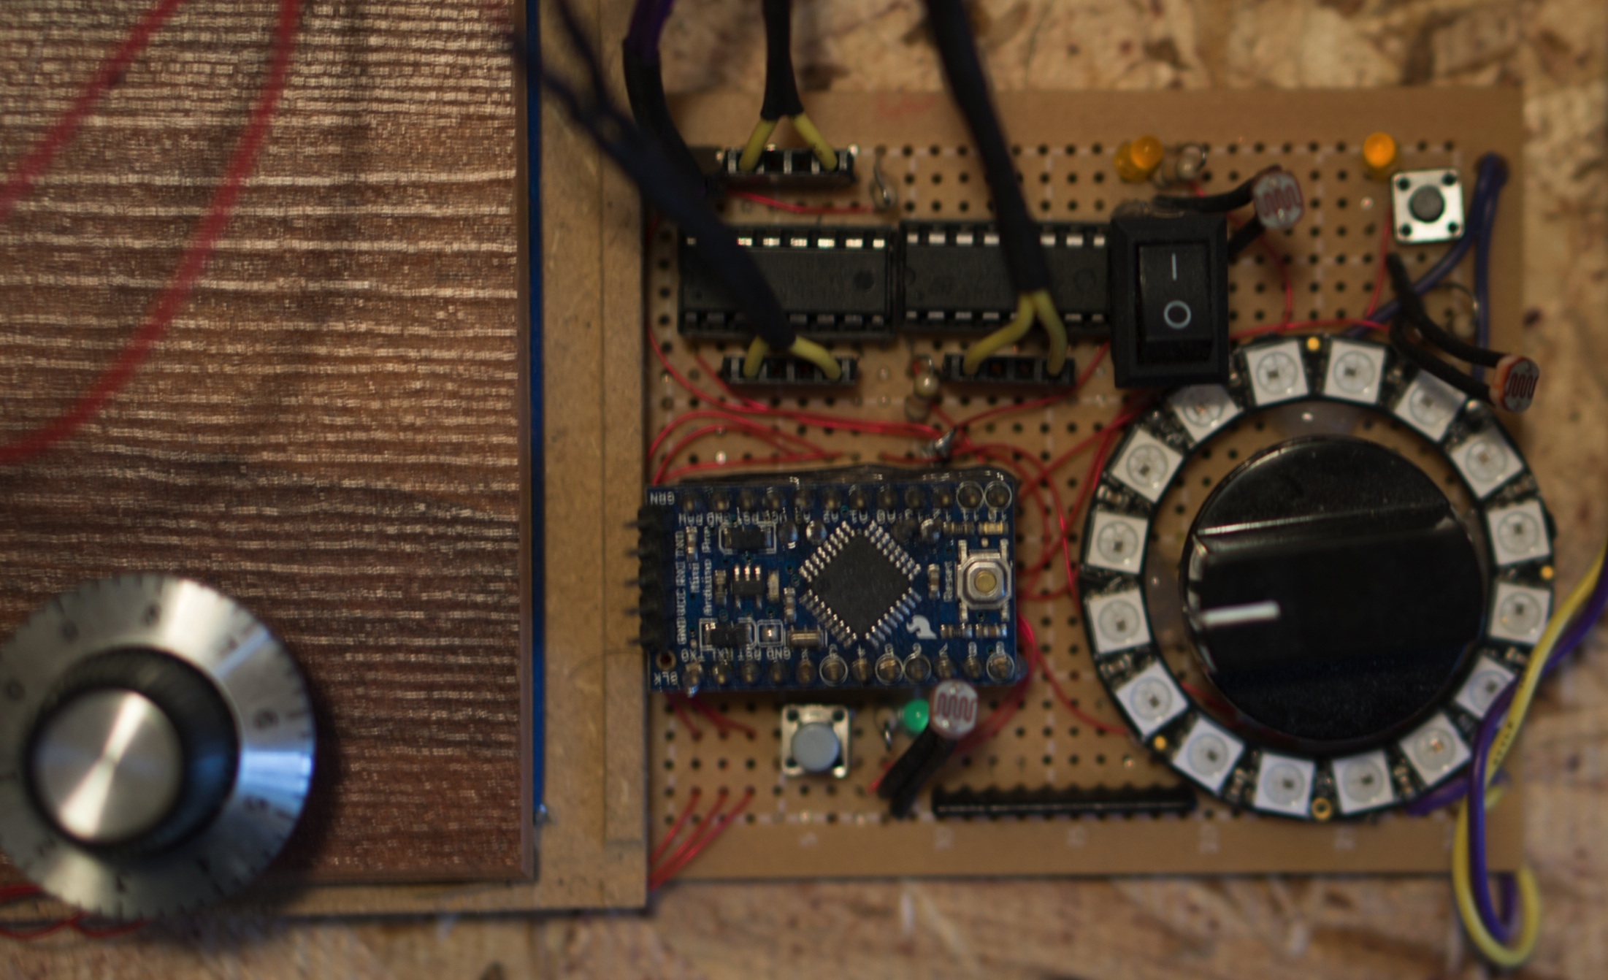

Slide 13
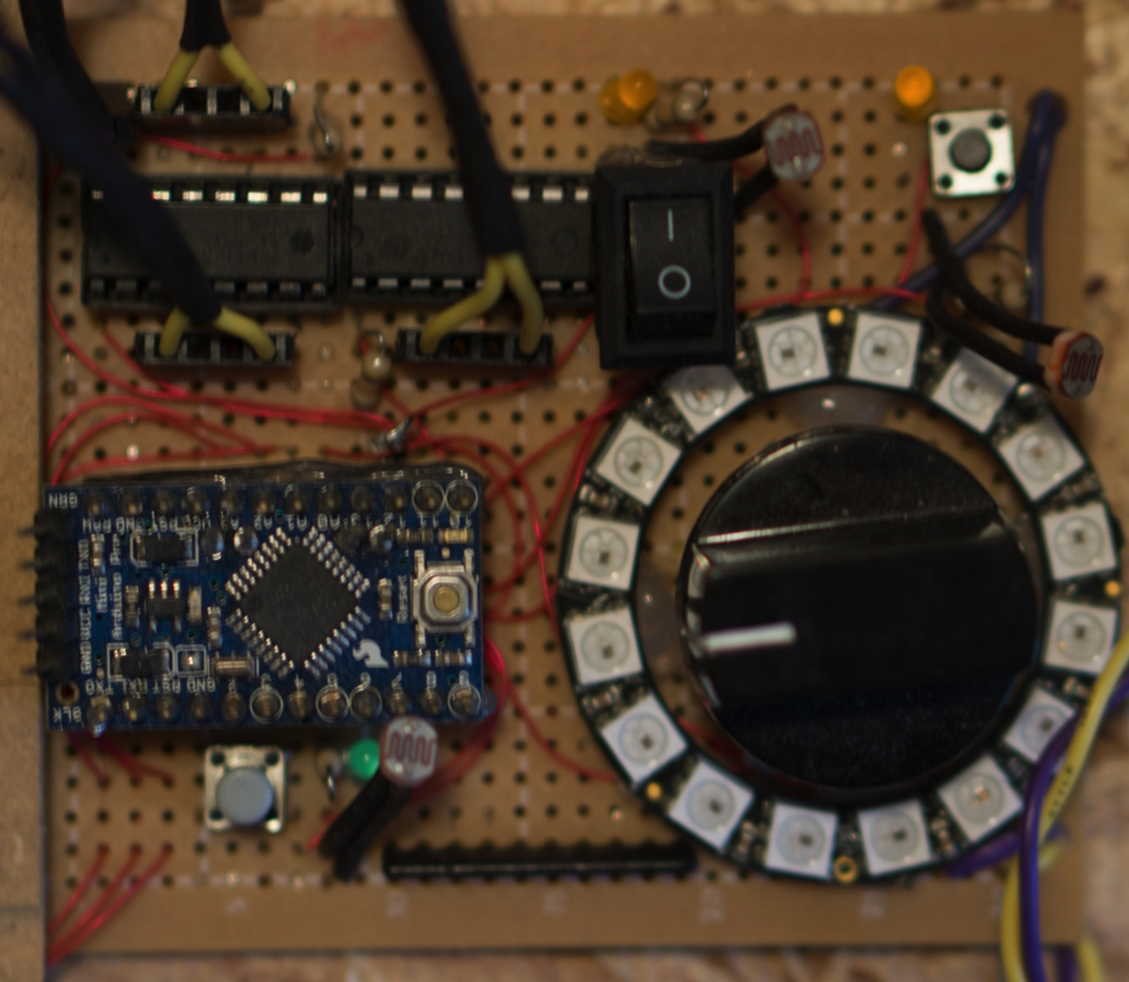
PWM to motors
Power to laser
Power
Analog from knobs

Slide 14
Arduino Pro Mini 5v (brain & storage)
H-Drivers (motor power)
LED circle (display)

Slide 15
Arduino Pro Mini 5v (brain & storage)
H-Drivers (motor power)
LED circle (display)
Buttons (function switching)

Slide 16
Arduino Pro Mini 5v (brain & storage)
H-Drivers (motor power)
LED circle (display)
Buttons (function switching)
Photoresistors (hand control)

Slide 17
Challenges
Motor mounting & alignment
Stability vs Noise
Laser mounting

Slide 18
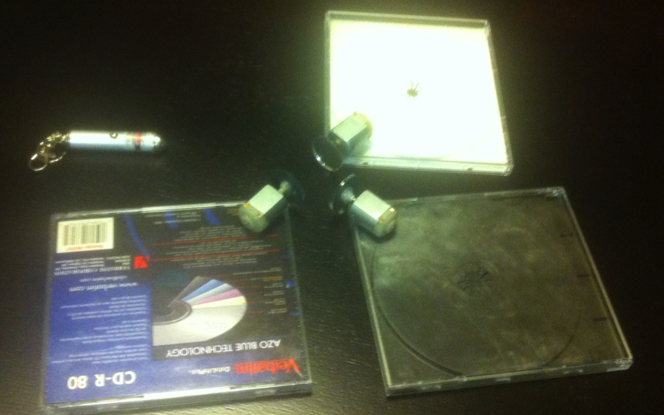
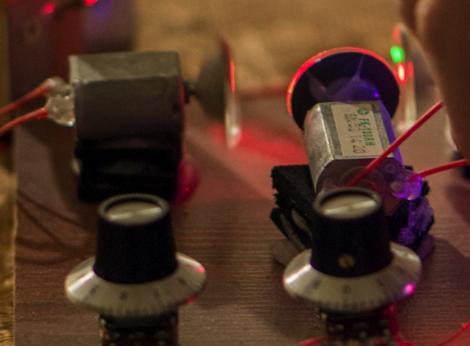
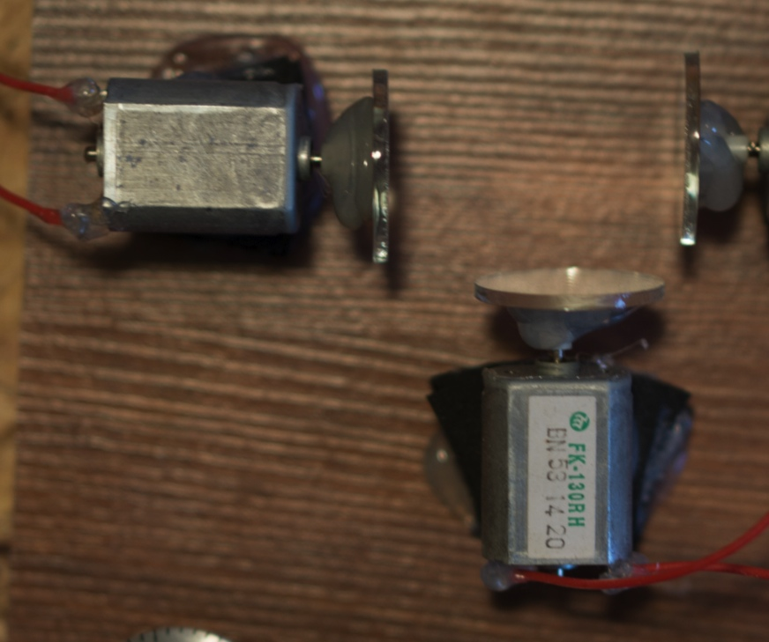
Challenges
Motor mounting
& alignment

Slide 19
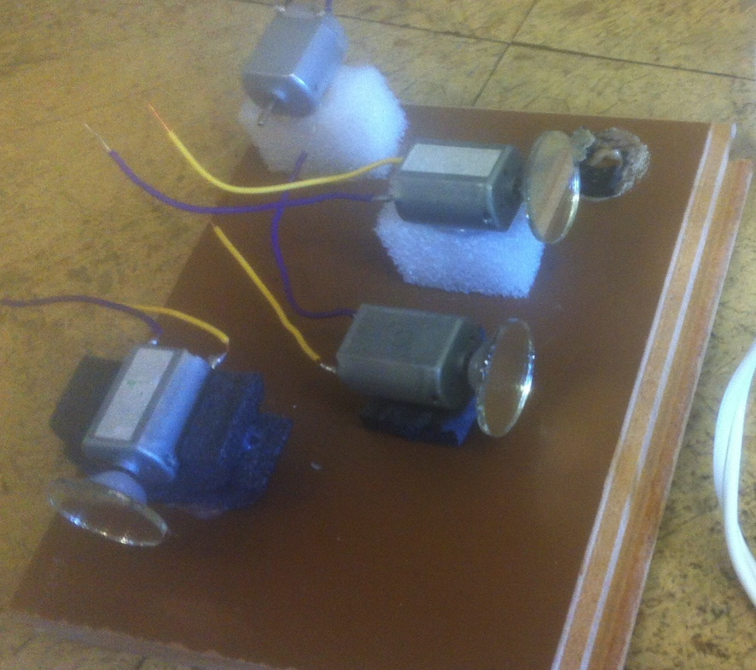
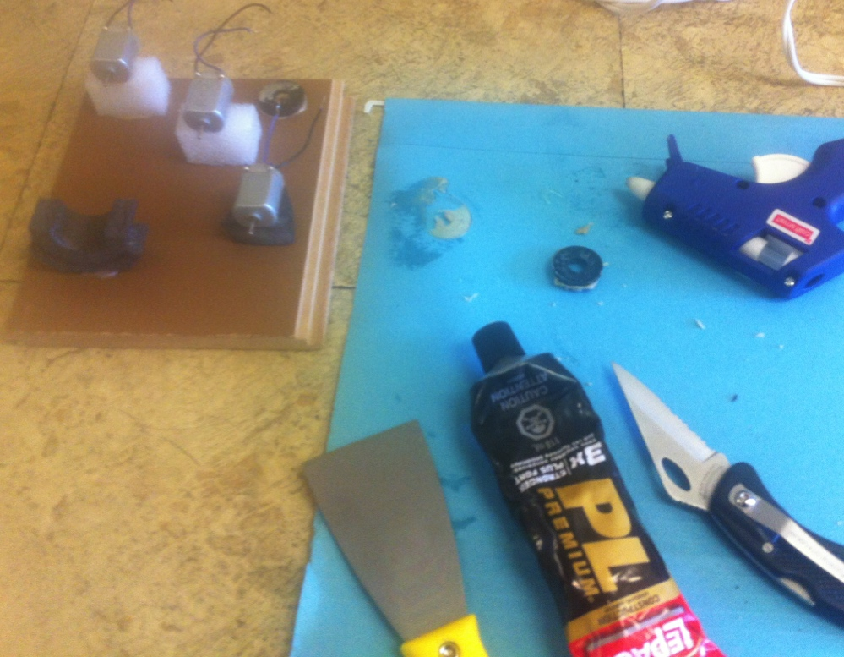
Challenges
Motor mounting & alignment
Stability vs Noise

Slide 20
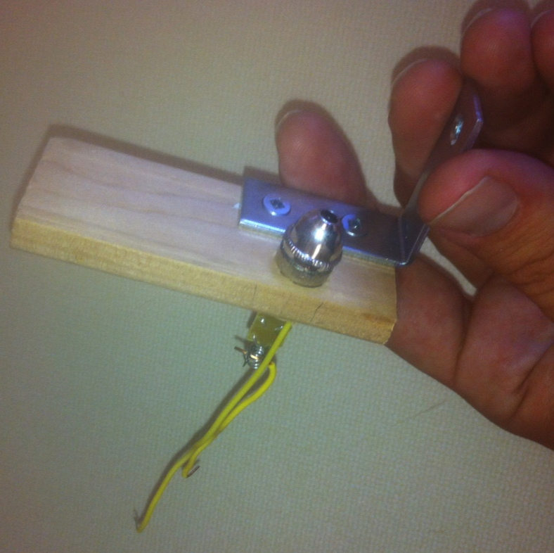
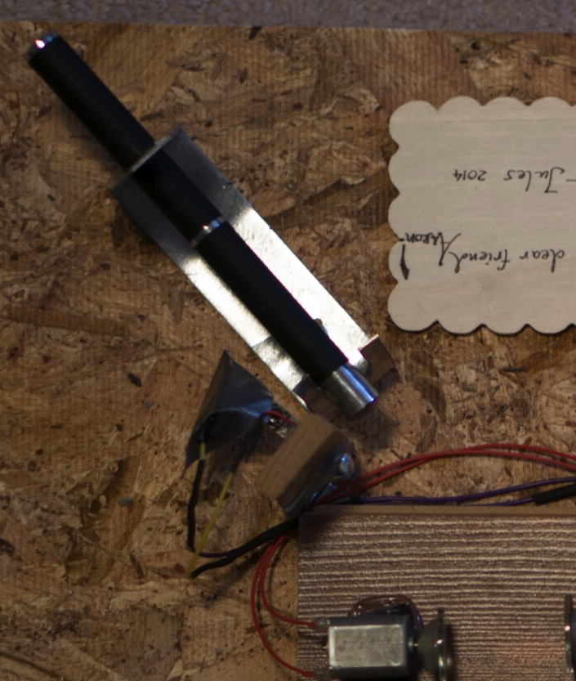
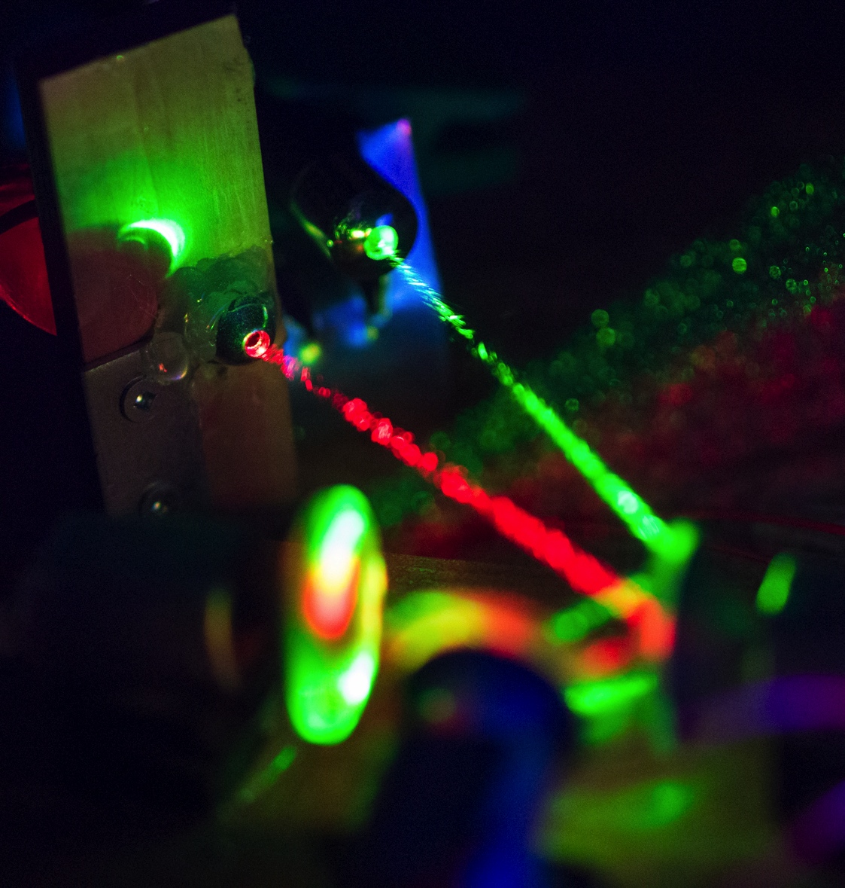
Challenges
Motor mounting
Stability vs Noise
Laser mounting

Slide 21
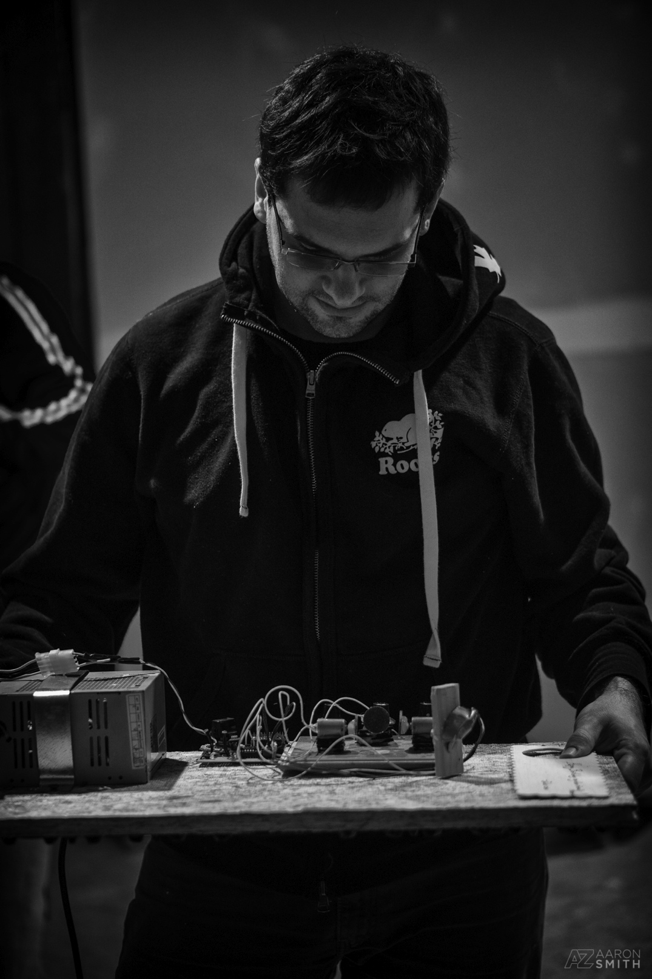
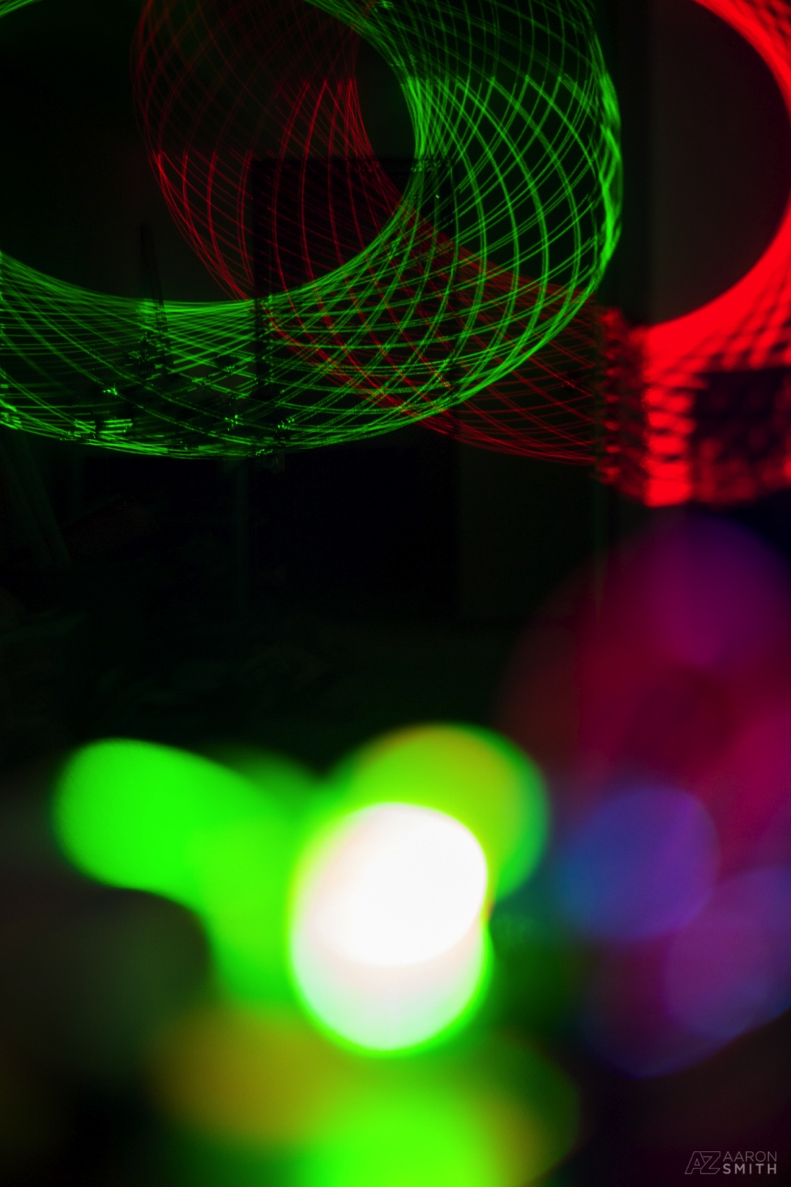
Thanks!
iulian.gt@gmail.com

